Slide 1

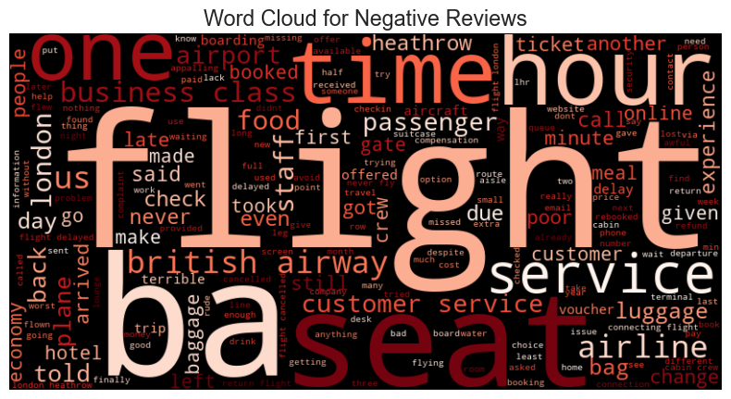

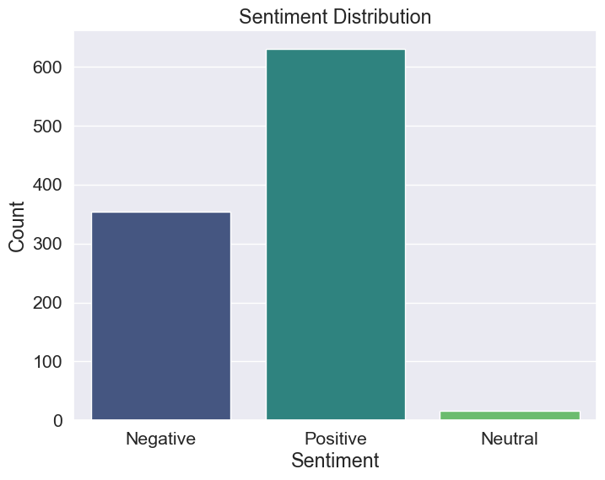
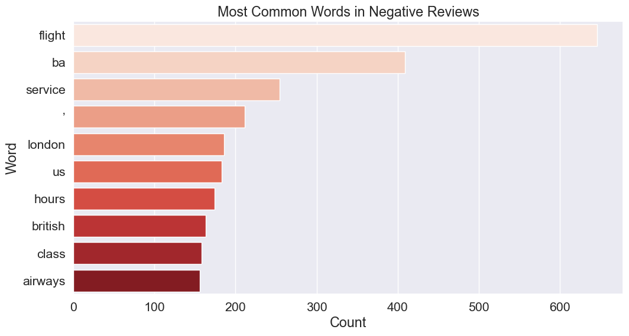
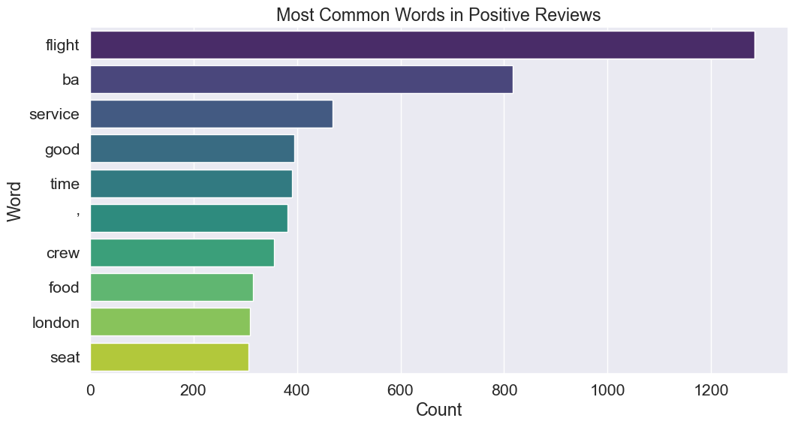
INSIGHTS FROM CUSTOMER REVIEWS
From cleaning 1000 reviews given by the customers, we obtained
Positive Reviews - 630
Negative Reviews - 354
Neutral Reviews – 16

